Slide 1
Short text classification for Arabic social media tweets

Slide 2
Introduction:
Twitter, a popular social networking platform, has an enormous volume of unstructured heterogeneous data–called tweets–posted by different users with high variability of types according to its content.
This study was conducted on tweets written in Arabic to enhance information retrieval, whether for personal or research purposes, e.g., news filtering, chasing fake news, rumors, opinion mining, etc.
For this, text classification method is used.

Slide 3
Text classification:
Text classification is the process of assigning class or category to the text from a set of pre-defined categories according to its content
Formally, suppose “D = d1; d2; ... ; dn” is the set of training documents. Assume that each dataset in D is assigned to a set of classes “C= c1; c2; ... ; cm”.
The text classification develops a model whereby given a new document d€ D it will be assigned to a class in C.

Slide 4
Framework:
Our objective is to classify the Arabic tweets into a predefined set of categories.
For this, we used a dataset of Arabic tweets
Before text classification, the data passed through several processes:
Text preprocessing
Feature extraction
Machine learning to assign the text into one of the pre-defined categories

Slide 5
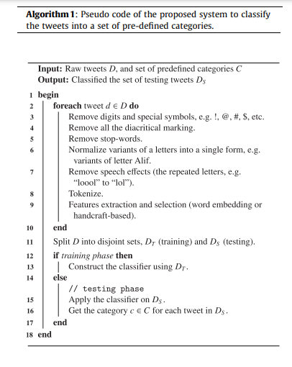

Slide 6
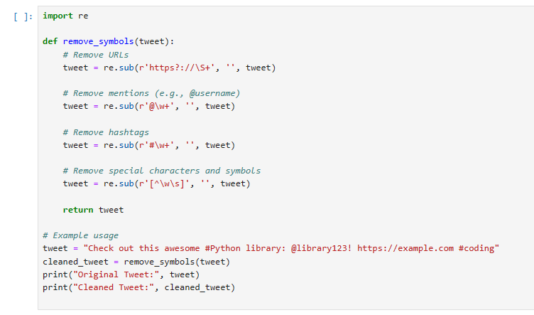
Preprocessing:
For the Arabic language, text preprocessing includes several processes:
Removing symbols like URLs, ‘‘#” (hashtag), ‘‘@” (mention), RT (retweet), and EOL (end of line) using Regular expression operations

Slide 7
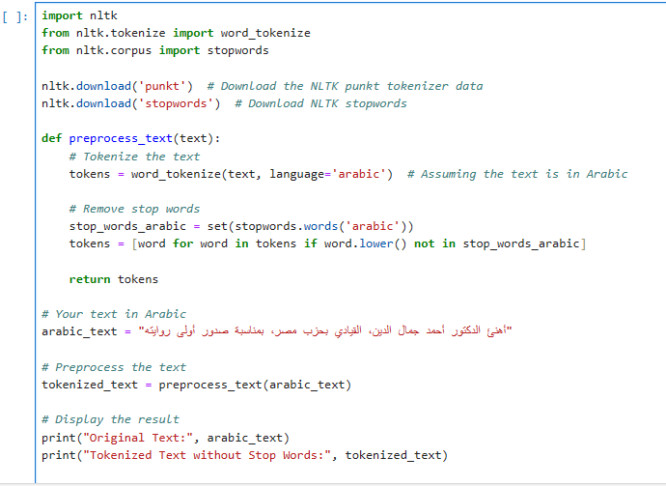
Preprocessing:
Using NLTK (Natural Language Toolkit) library, remove stop words

Slide 8
The out put:
Original Text: أهنئ الدكتور أحمد جمال الدين، القيادي بحزب مصر، بمناسبة صدور أولى روايته
Tokenized Text without Stop Words: ['أهنئ', 'الدكتور', 'أحمد', 'جمال', 'الدين', '،', 'القيادي', 'بحزب', 'مصر', '،', 'بمناسبة', 'صدور', 'أولى', 'روايته']

Slide 9

Features extraction and selection:
Handcraft-based feature
Stemming: where each word in the tweet is reduced to its root (or stem) form based on the stemming algorithm.
Weighing: TFIDF is a weighting factor intended to reflect how important a word is to a document in a corpus. It measures a specific word’s total number of occurrences in a given document, termed ‘‘term frequency”.

Slide 10
Word embedding
Word embeddings are fixed-length vectors, distributed, dense representations of words that interpret a word’s textual meaning by mapping it to a vector of real values.
It captures the semantic relationships between words, so similar words are represented by vectors that are close to each other in the space.
Word2vec is a two-layer neural network, where the input is the document and the output is a set of real-valued feature vectors–one vector per word–of a pre-set fixed dimension.

Slide 11
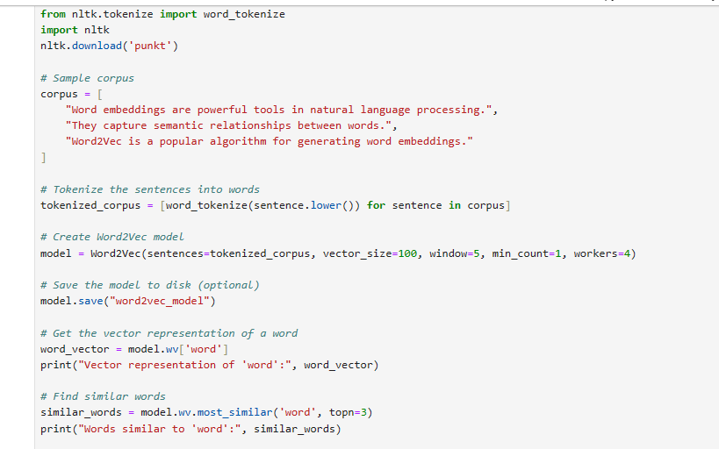

Slide 12
Learning algorithms:
Continuous bag-of-words (CBOW)
Skip-gram (SG)
We predict the current word using a window of surrounding words
It increases the computational complexity
We predict the surrounding context words given the center word
we maximize the probability of a word being in specific content in

Slide 13
Training models:
A pre-trained word embedding model.
AraVec which is an open-source Word2vec project pre-trained on different Arabic text resources.
It represents words as vectors in a continuous vector space. Developed by researchers at Google, the Word2Vec algorithm is capable of capturing semantic relationships between words based on their context in a large corpus of text.

Slide 14
Results were disappointing

Slide 15
We then switched to ArWordVec, another pre-trained model implemented in python using Gensim packag.
This model is trained using a huge repository of 55M Arabic tweets in different topics, with over 80% of the tweets belong to two topics: politics and geographical.

Slide 16
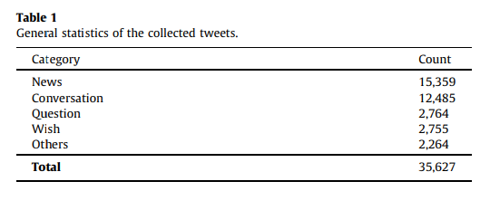
Dataset:

Slide 17
Evaluation and Results:
This section is divided into smaller units:
hypertuning the parameters of the classifiers used
the evaluation metrics
experimental results
discussion of the results

Slide 18
Hypertunning parameters:
To enhance the performance of each classifier, we tuned their respective hyperparameters
We used a randomized search over parameters, where each setting is sampled from a distribution over possible parameter values
We show the tuned parameters for the two stemmers
The method used here is Random Forest (RF) which is used to solve classification (categorical target variable) problems

Slide 19
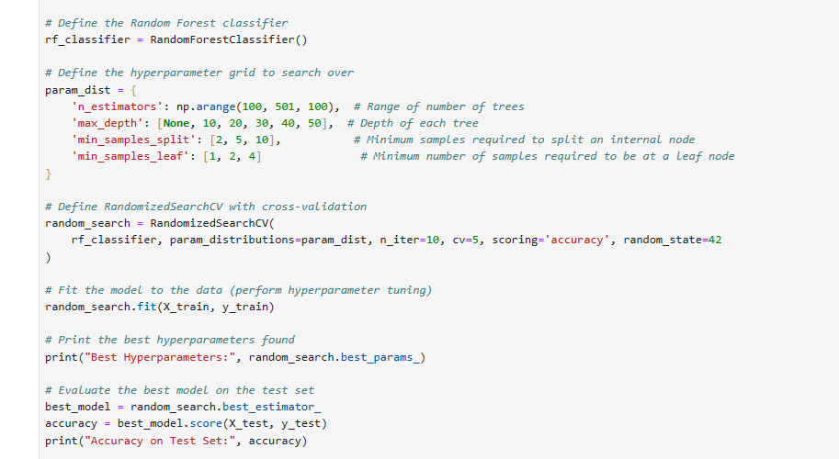

Slide 20
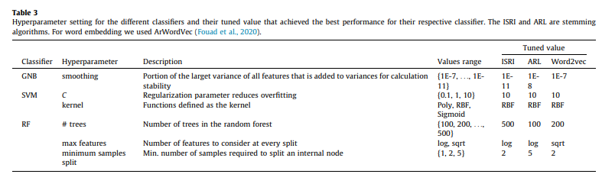

Slide 21
Selecting features:
To select the best features, K-best method is used
We select the k-best method with v2 to assess each feature’s relevance to the target variable using Scikit-learn.

Slide 22
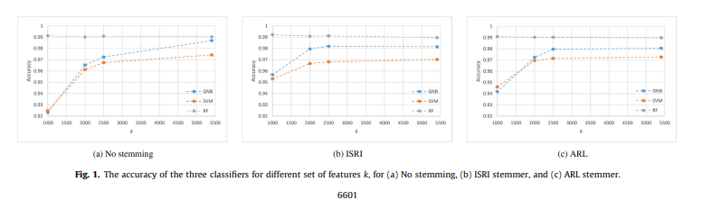

Slide 23
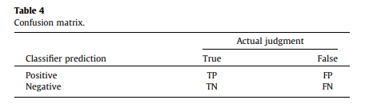
Evaluation metrics:
To assess the performance of the proposed system, we measure the effectiveness of the system in terms of accuracy, precision, recall, and F1 score.

Slide 24


Slide 26
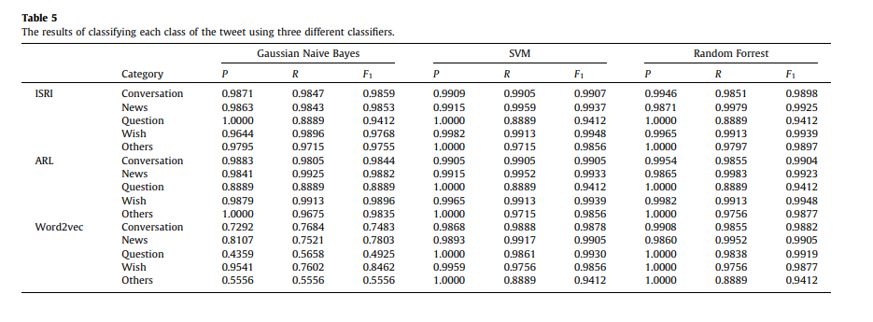

Slide 27
The study randomly divides the collected data into a 70% training set and a 30% testing set. The classification results for individual classes are presented, and the findings are detailed below:
ISRI Stemmer:
GNB classifier achieves its best performance on the "Conversation" class with an F1 score of 98.59%.
SVM and RF classifiers both achieve their best performance on the "Wish" class, with F1 scores of 99.48% and 99.39%, respectively.
ARL Stemmer:
The "Wish" class exhibits the best performance, with F1 scores of 98.96%, 99.39%, and 99.48% for GNB, SVM, and RF classifiers, respectively.
Word2vec Model:
GNB achieves its best performance on the "Wish" class with an F1 score of 84.62%.
Surprisingly, for the "Question" class, GNB reports its worst performance (49.25%), while SVM and RF achieve their best, with F1 scores of 99.30% and 99.19%, respectively.

Slide 28
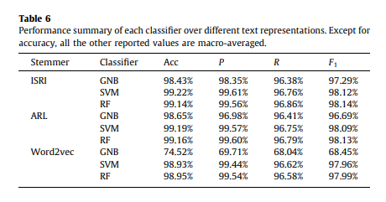

Slide 29
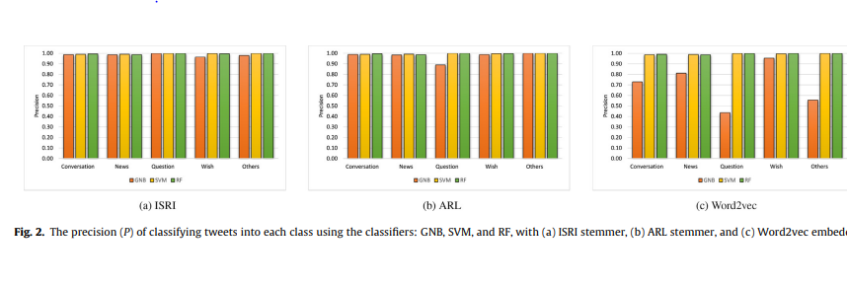

Slide 30
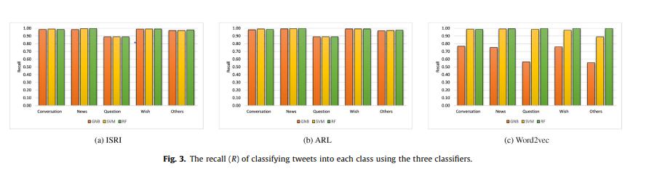

Slide 31
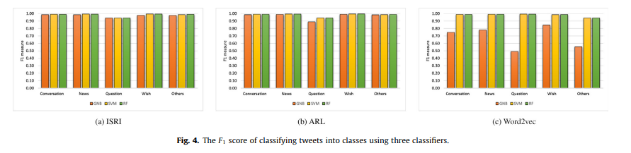

Slide 32
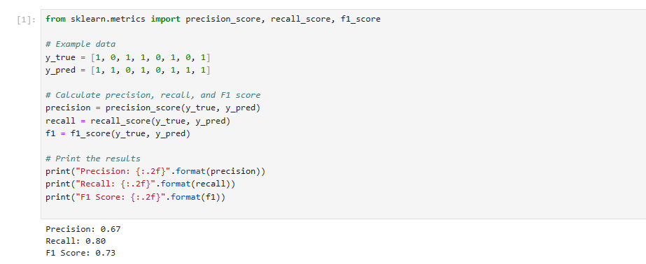

Slide 33
Paired t test:
The paired t-test is applied to compare the F1 scores of GNB and SVM classifiers using the ISRI stemmer, and the reported p-value of 0.0253 is below the significance level of 0.05, indicating that the difference in F1 scores between the two classifiers is considered statistically significant for this particular case.

Slide 34
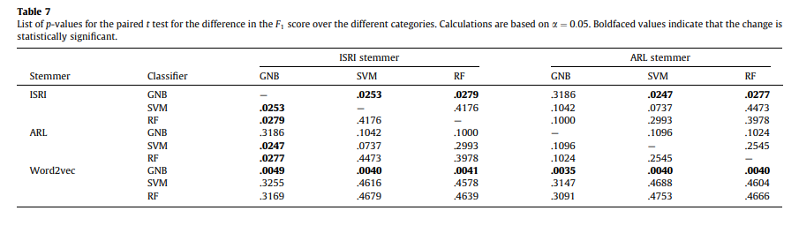

Slide 35
The difference between their top performances was insignificant, statistically speaking.
The best macro-F1 score is 98.14%. Another interesting observation is the adverse effect the word embedding had on all three classifiers, particularly the GNB classifier, compared to their performance using the stemming.

